Slide 1
Faculty of Geography and Geoinformation Technologies of the Higher School of Economics
The boundaries of the Kama agglomeration and the hierarchy of its centers
Oparin Roman Denisovich
Scientific supervisor: Sheludkov Alexander Vladimirovich; asheludkov@hse.ru
Moscow, 02.04.2024, IVth Student Conference

Slide 2
problem statement and relevance of the research topic
During the post–Soviet period, Russia remains a country with a high level of urbanization - 74.8% (Rosstat, 2022), the process of population pulsation is reflected in the development of agglomeration forms of settlement.
The existing methods have been developed mainly for monocentric agglomerations.
Tasks of territorial planning (development of road and social infrastructure, …).

Slide 3
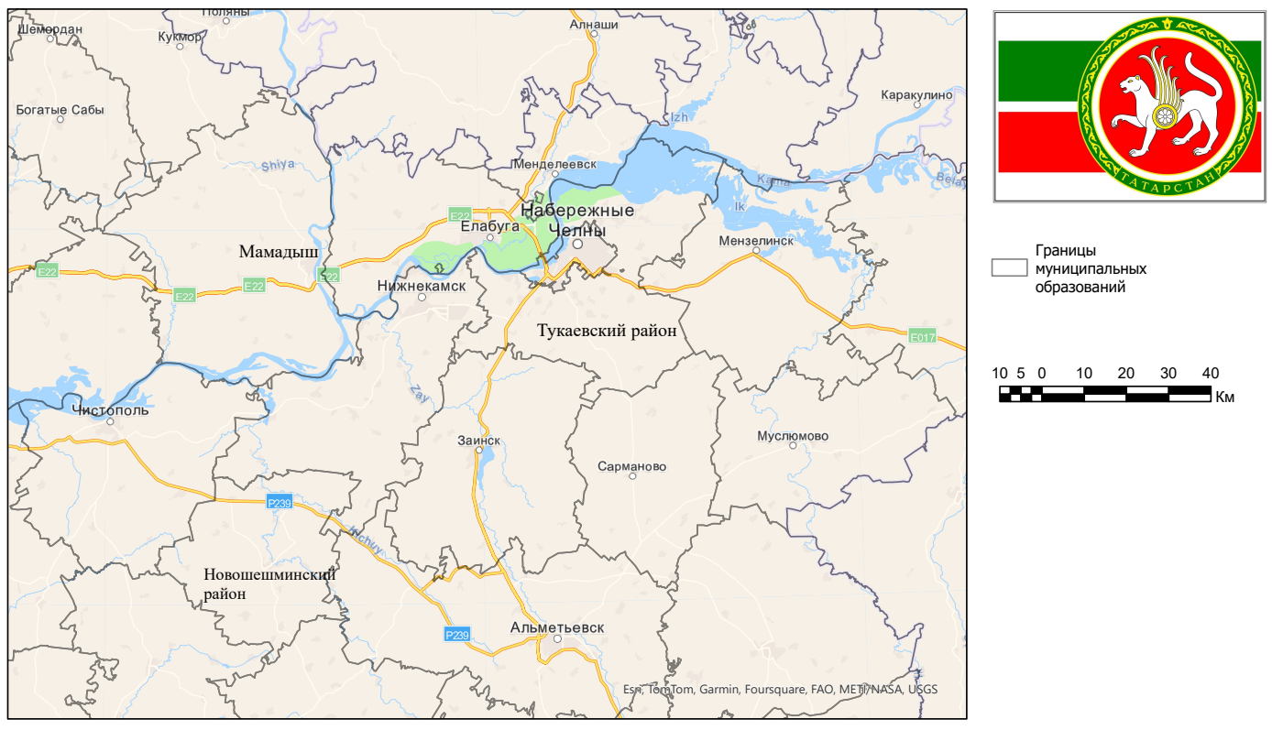
goals and objectives of the project
Goals:
Comparison of the possibilities of different approaches and methods for the allocation of nuclei and delimitation of boundaries of polycentric agglomerations on the example of the Kama agglomeration.
Object of research: Kama agglomeration
Subject of research: boundaries and cores

Slide 4
DATA AND METHODS
Methods:
1. Morphological.
2. Functional-settlement.
Data:
Database of municipal indicators.
Personal income tax according to certificate number 5.
Open grid data on building and population density (GHSL), nighttime radiation intensity in the visible and near infrared spectrum (VIIRS DNB).
Graph of the road network from OSM.
Allocation of the centers of the Kama agglomeration according to population density and building density, intensity of night radiation
Defining the boundaries of the Kama agglomeration based on modeling transport accessibility, calculating the proxy balance of labor migration
Morpholo-gical approach
Functional- settlement approach

Slide 5
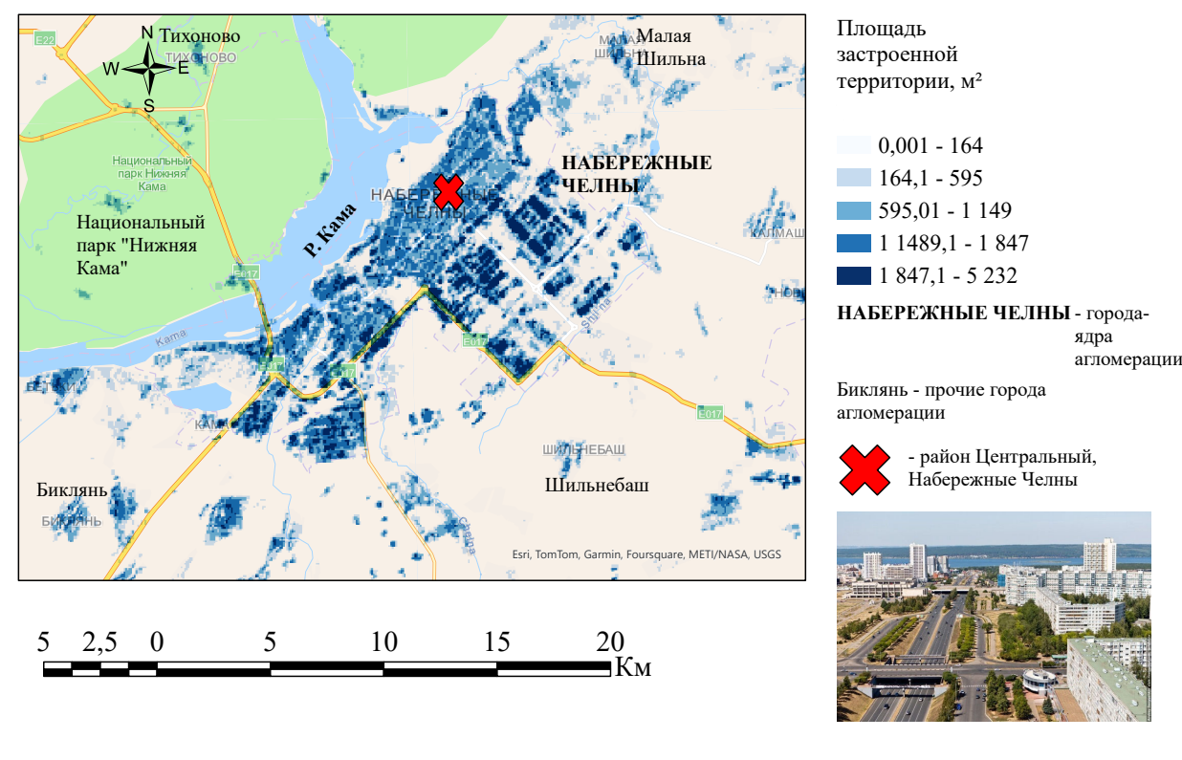
The cores of the Kama agglomeration. Building density
1. Clusters on the territory of the industrial zones of Nizhnekamsk and Naberezhnye Chelny.
2. Uniform, gradually built-up microdistrict layout of buildings and structures.
Fig. 1. Building density in Naberezhnye Chelny, m² in a cell of 100*100 m. Compiled by the author using open grid data from GHS-BUILT-S (Pesaresi, Politis, 2023).

Slide 6
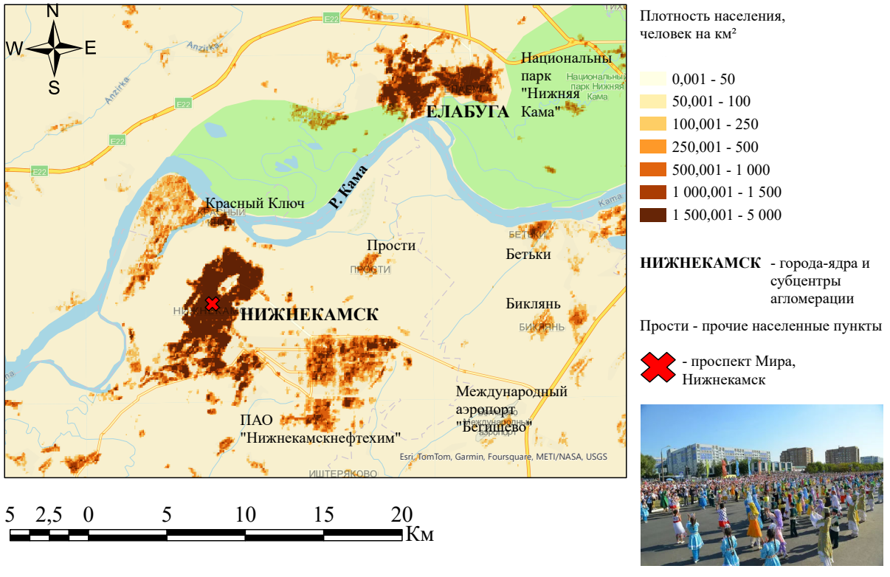
The cores of the Kama agglomeration. Population density
It is difficult to identify areas of higher or lower development.
The contrast between suburbs and industrial facilities and urban development.
Fig. 2. Population density in Nizhnekamsk and Yelabuga, people / km². Compiled by the author using GHS-POP open grid data (Schiavina et al., 2023).

Slide 7
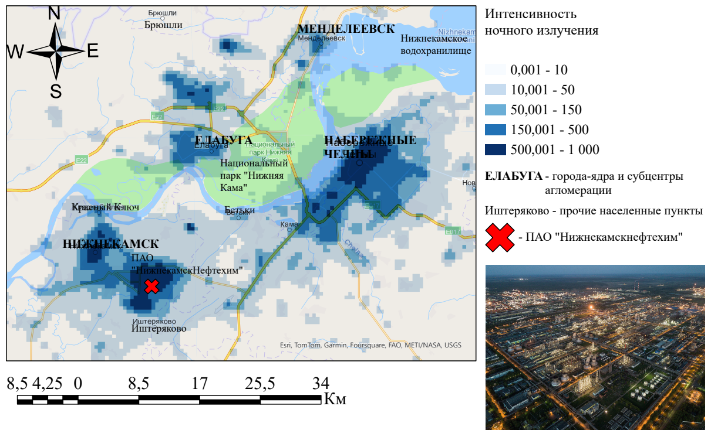
The core of the Kama agglomeration. Intensity of night radiation
A large number of "emissions" from petrochemical and automotive enterprises.
Two clusters (the Central residential area in Naberezhnye Chelny and the industrial zone of the PJSC Nizhnekamskneftekhim plant) were identified as centers.
Fig. 3. The average annual intensity of night radiation in the visible and near infrared spectrum in 2023, nWt·cmˉ²·cpˉ¹. Compiled by the author according to NASA's Black Marble (Román et al., 2018).

Slide 8
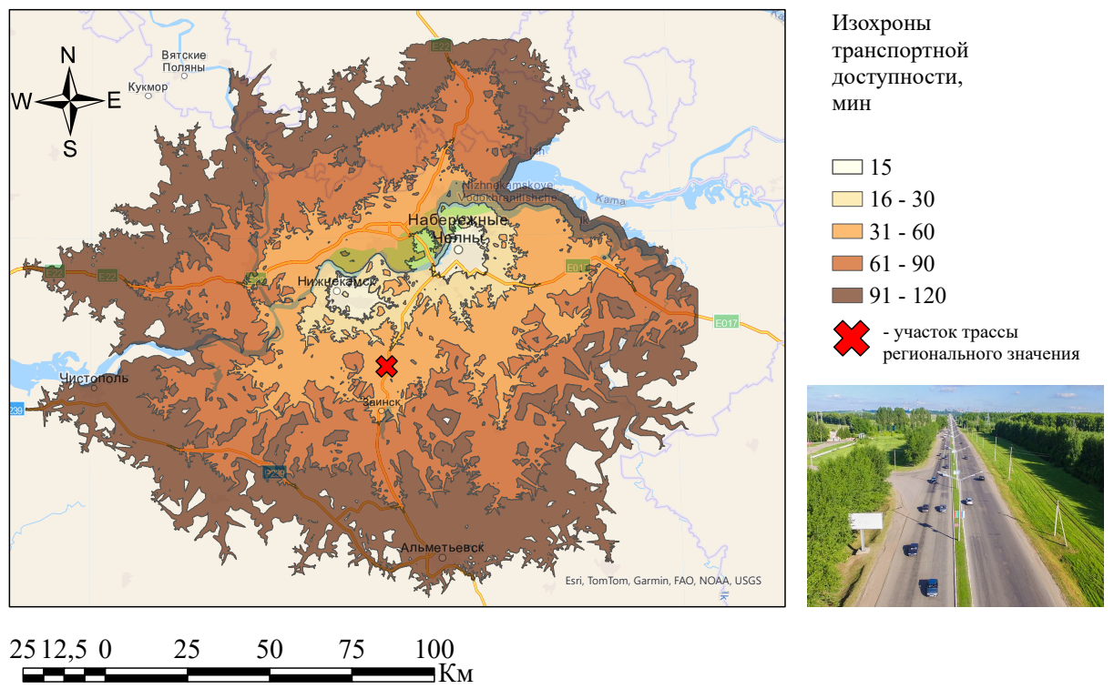
Agglomeration boundaries: criteria for transport accessibility
The availability time between the two main cores of the agglomeration is 30 minutes.
Most of the subcenters of the Kama agglomeration (Yelabuga, Zainsk, Mendeleevsk, Menzelinsk) are located in the hourly accessibility zone.
Fig. 4. Transport accessibility of the centers of the Kama agglomeration, min.

Slide 9
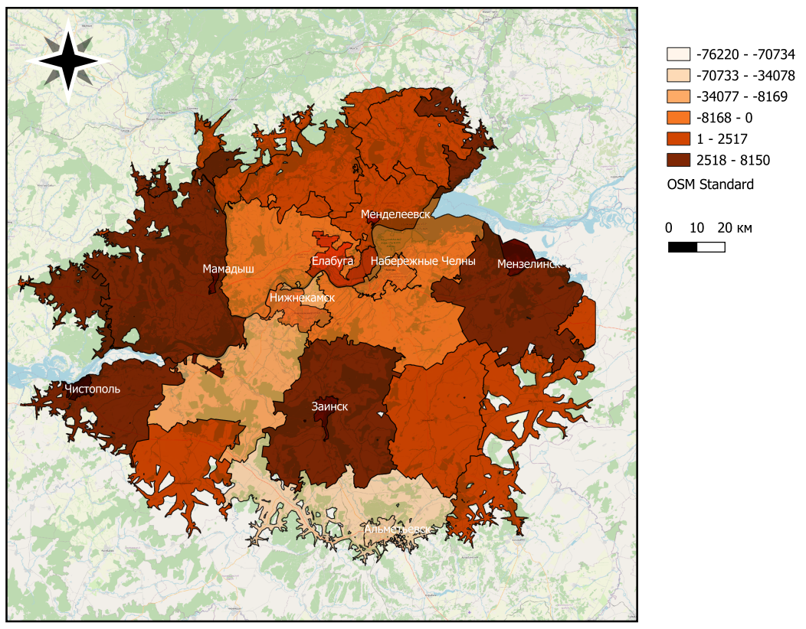
Agglomeration boundaries: the criterion of pendulum labor migration
The lowest (negative) indicators are typical for the cities of Naberezhnye Chelny, Nizhnekamsk, Yelabuga.
The majority of districts and some subcenters of the agglomeration (Zainsk, Mamadysh, Menzelinsk, Mendeleevsk) are characterized by positive values of the indicator.
Fig. 5. Assessment of the pendulum labor migration of the Kama agglomeration, people.

Slide 10
conclusions
The most important points of attraction of the agglomeration form a fairly compact settlement system.
The morphological approach is more effective in isolating the boundaries of the nuclei, and the functional-settlement approach is more effective in isolating the boundaries of the agglomeration as a whole.
Difficulties related to the relevance and accuracy of the data, as well as the presence of outliers.
The use of new "alternative" methods of delimitation of agglomerations; the study of other polycentric agglomerations.

Slide 11
THANKS
FOR YOUR ATTENTION

